Slide 1

Nasdaq- Assignment
Submitted by Dinesh Kumar
Date -22-Oct-2024

Slide 2
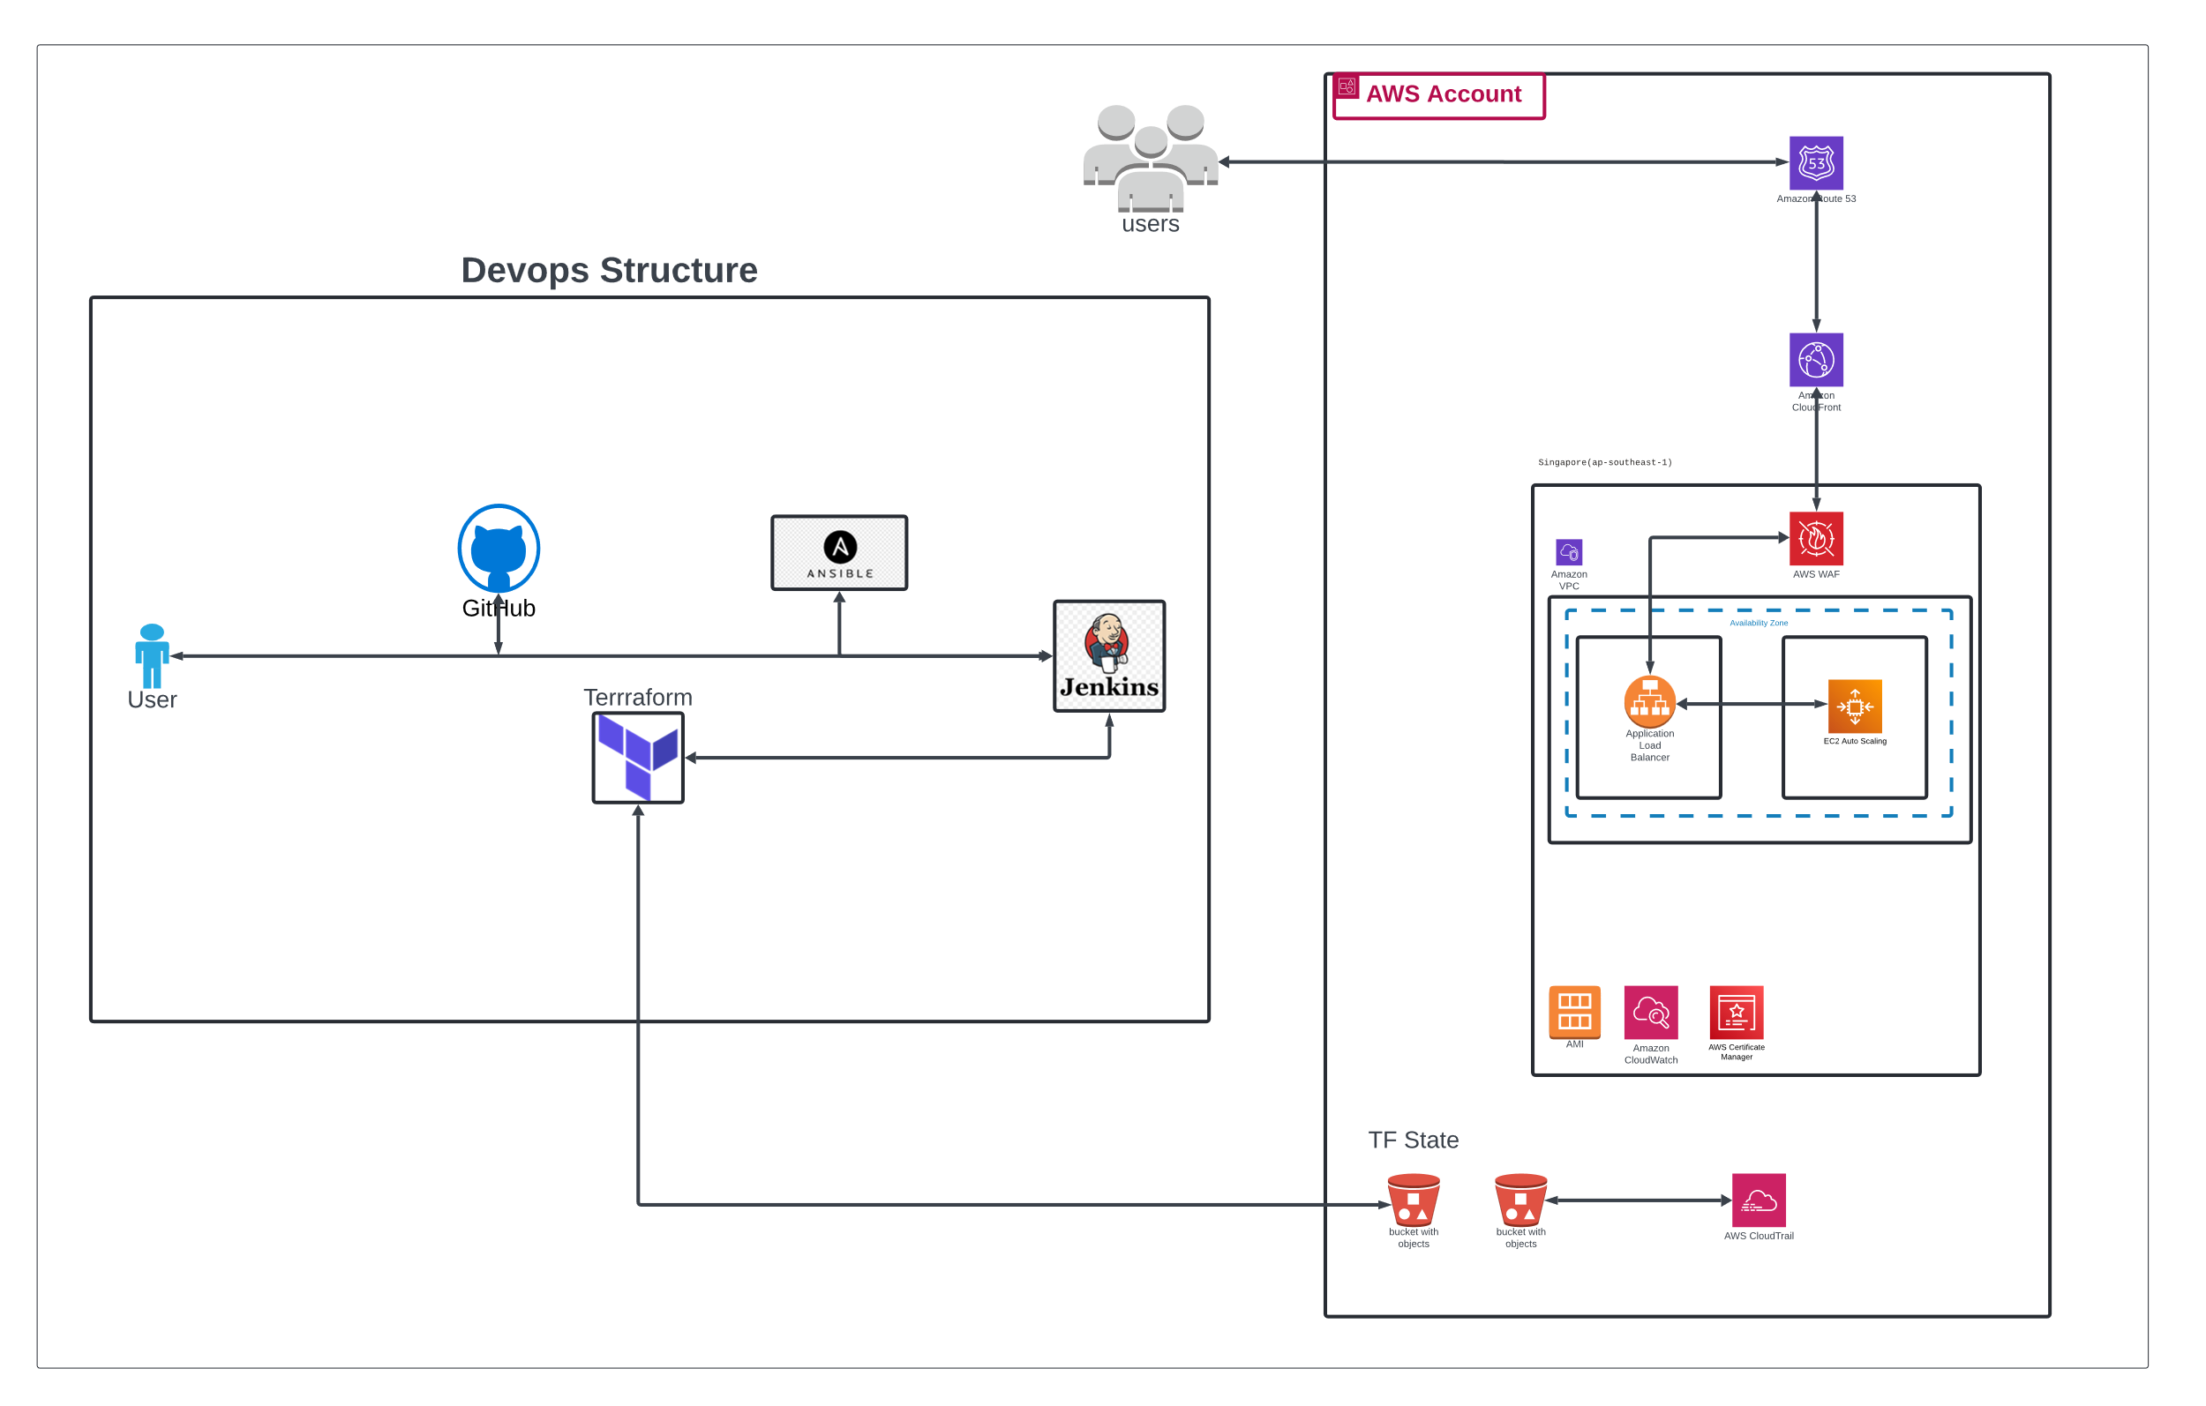
Architecture Diagram
Click on the Link for Lucidchart diagram…..

Slide 3
List of services used for the assignment
EC2 Autoscaling → For Scalability and optimization depends on the load
2
Application load balancers → Load sharing across the vm’s and high availability within region
3
4
5
6
7
8
9
10
VPC → For Subnets, Application configuration, administration and BAU activities etc.
S3 buckets → Storing Terraform State file, Audit logs and log storage
WAF → Secure from the threats like DDOS attack, SLQ injection and bad traffics etc.
Cloud Front→ For Latency, static content distribution
Route 53 → DNS management
Certificate Manager → For SSL certificate and secure communication with endser
Cloud Trail → For audit purpose, capturing and storing in the S3
Cloud Watch → For infra and application monitoring and log management
1

